Slide 1

SAP BTP ABAP on Cloud / RAP Training
DAY-26
Anubhav Oberoy
www.AnubhavTrainings.com
Follow excellence with sheer passion

Slide 2


DISCLAIMER
The training content and delivery of this presentation is confidential, and cannot be recorded, or copied and distributed to any third party, without the written consent of Anubhav Trainings

Slide 3

01
Generate Fiori App
02
Structure of Fiori App
03
CIS Service
04
Build Workzone
Notes:
https://pixabay.com/photos/san-francisco-transamerica-pyramid-1633203/

Slide 4
Structure of the Fiori App
Currently you are testing the Fiori App by using the standard preview option in eclipse tool. Will our end user have the ability and skill to open eclipse tool, go to package and search BIMP and then open preview and that too in production system.
All the Fiori apps which we create in BTP will be called MTA – Multi target application, they are deployed with mta.yml file. Which will contain the configuration for the Fiori App.
In SAP BTP, there is a storage space called html-5-repository where the BTP will store our Fiori apps.
When we deploy our app, there is html5-deployer which will take our app from BAS tool and deployes it to the HTML5 Repository (Design time)
When we run the app, there is a service called html5-rt (runtime) service which will load our app from the repository in the build workzone.
Apart from that the application will contain a connectivity service to communicate with our abap on cloud system.
And a destination service which will read the destination (RFC) of AOC system to access data in Fiori.
www.anubhavtrainings.com

Slide 5
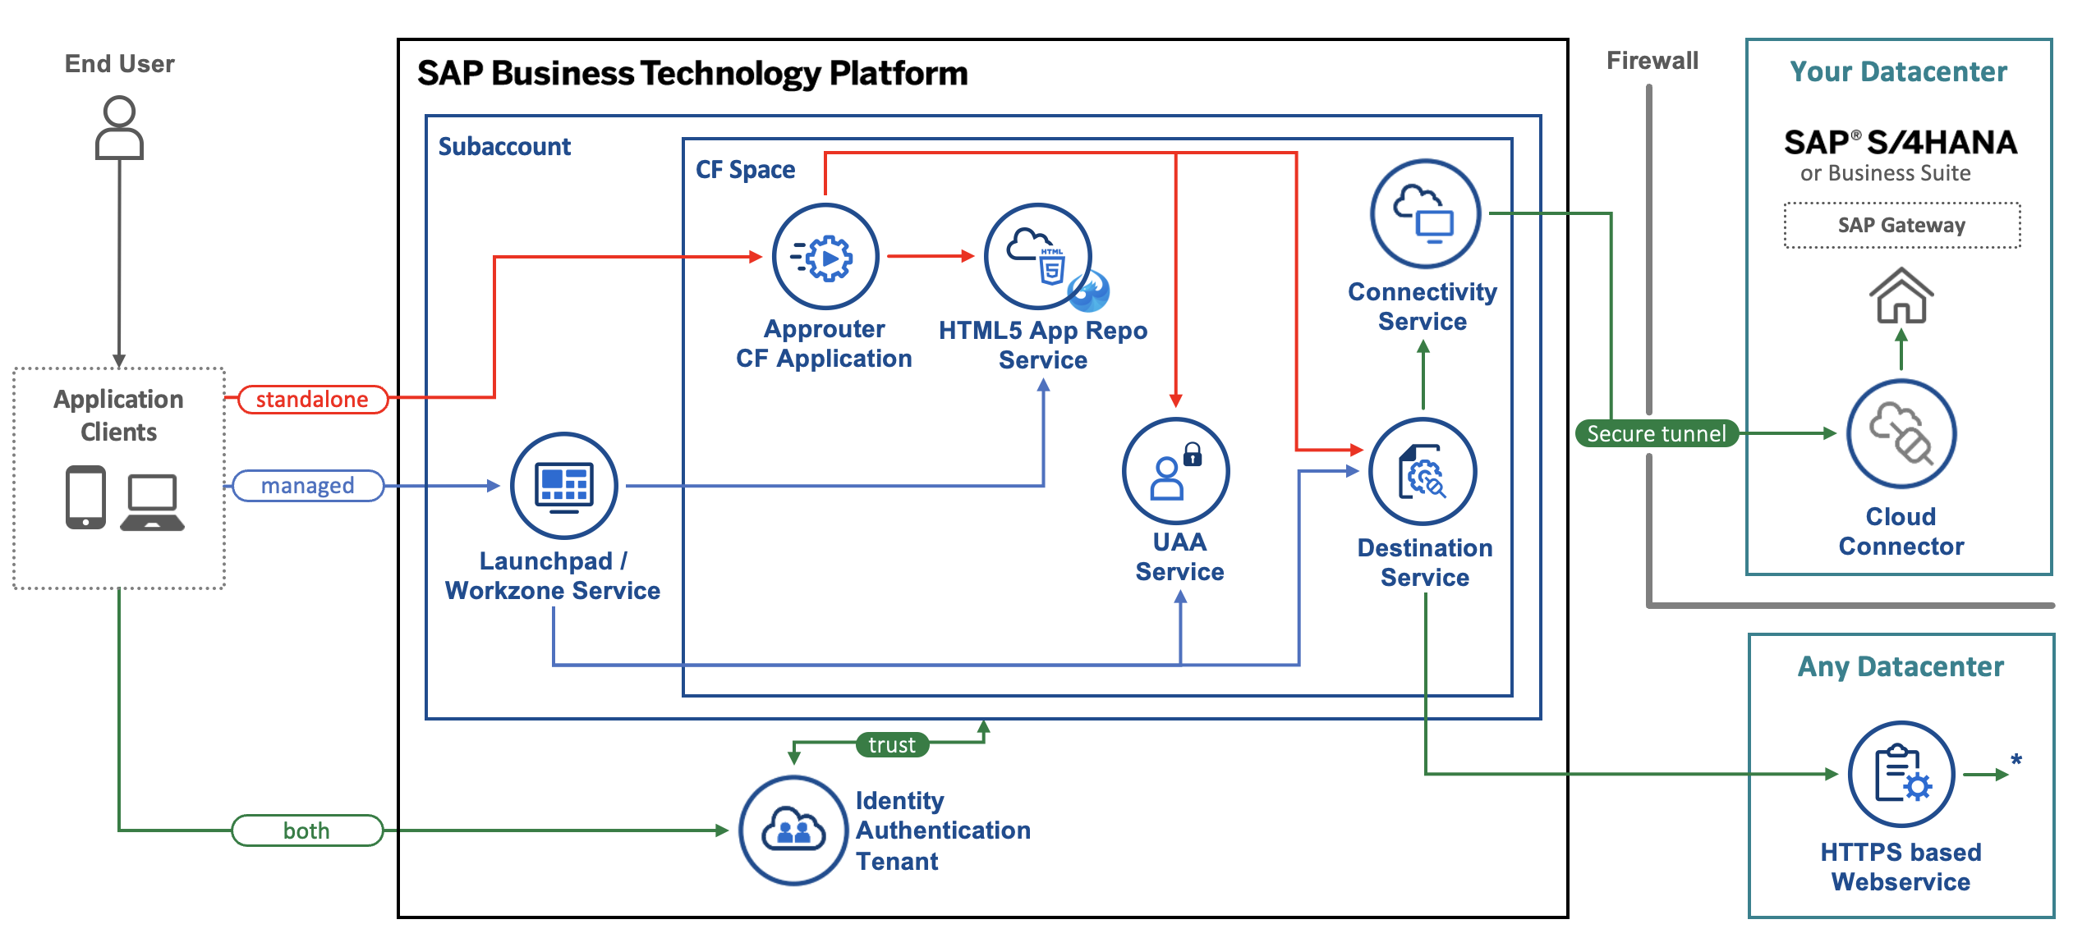
Architecture
www.anubhavtrainings.com
Notes:
https://www.google.com/url?sa=i&url=https%3A%2F%2Fcommunity.sap.com%2Ft5%2Ftechnology-blogs-by-sap%2Fbuild-and-deploy-ui5-freestyle-applications-to-sap-btp-cloud-foundry%2Fba-p%2F13558501&psig=AOvVaw3K_6niI7dmyPfs2VgcYMQf&ust=1726066695091000&source=images&cd=vfe&opi=89978449&ved=0CBcQjhxqFwoTCOicgdPRuIgDFQAAAAAdAAAAABAg

Slide 6
Tools and Services to Deliver the App
Business Application Studio – It is a multi cloud development tool which allows developers to build, test, package, deploy, and manage end to end Fiori applications.
SAP build work zone (aka cFLP in BTP) – it helps us to configure a site called Fiori launchpad in the cloud. All the Fiori Apps which you build in BTP will be accessed via this build workzone from end user. End user will get single URL, which contains the tiles for all our apps deployed in BTP.
Continuous Integration Service – When a developer change the application, and push to central repository like git, the CI service will automatically build and deploy our app.
www.anubhavtrainings.com

Slide 7
SAP Cloud Identity Service
SAP Cloud Identity Services is a suite of cloud-based identity and access management tools provided as part of SAP Business Technology Platform (BTP). It helps organizations manage user identities, authentication, and access across SAP and non-SAP applications.
Identity Authentication Service (IAS) is the core component acting as a cloud Identity Provider (IdP). It supports Single Sign-On (SSO), Multi-Factor Authentication (MFA), social login, and risk-based authentication. It can act as a proxy to corporate identity providers like Azure AD or Okta.
Identity Provisioning Service (IPS) automates the user lifecycle — creating, updating, and deactivating user accounts across connected systems. It uses the SCIM protocol and comes with pre-built connectors for SAP and third-party systems like Salesforce, Microsoft, and Google.
Identity Directory is the central user store within SAP Cloud Identity Services. It holds unified user profiles, groups, and custom attributes, serving as the single source of truth across the landscape.
Authorization Management provides fine-grained, policy-based access control. It allows administrators to define instance-level authorization policies for SAP BTP applications rather than relying solely on role-based access.
Security and Compliance features include GDPR readiness, ISO/IEC 27001 certification, audit logging, session management, and support for standards like SAML 2.0, OpenID Connect (OIDC), and OAuth 2.0.
www.anubhavtrainings.com

Slide 8





Request for a user in btp
Whats the mail?
BTP Admin
Anubhav
Developer
Raj Shetty
SAP Security
Subbu Swamy
Business User
Uday Shetty
Subscribe to Build Workzone
Subscribe to cloud identity service and appoint a administrator - Subbu
SAP Build Workzone
cFLP – Single Entry point for end users to access apps
dimogo1504@netoiu.com
SAP Cloud Identity Service
IDP – Identity provider
Subbu on-board himself as Admin for the cloud identity service of our a/c
Subbu needs to register the business user Uday shetty
A trust needs to be established with CIS and our BTP
SAP BTP

Slide 9
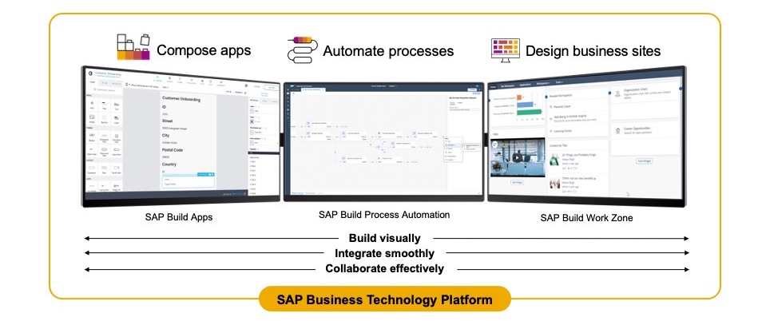
SAP Build – An introduction
www.anubhavtrainings.com

Slide 10
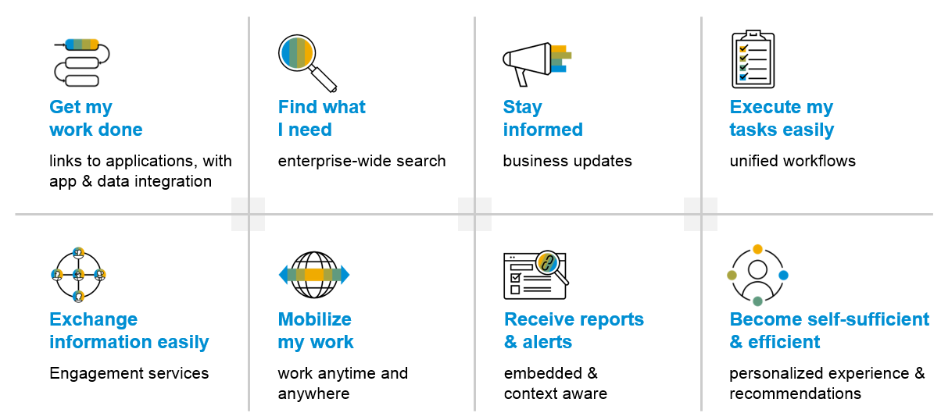
SAP Build Work zone – Key benefits
www.anubhavtrainings.com

Slide 11
Additional configuration before deployment
{
"xsappname": "comatstproctravelprocessorapp",
"tenant-mode": "dedicated",
"description": "Security profile of called application",
"scopes": [],
"role-templates": [],
"oauth2-configuration": {
"token-validity": 60000,
"refresh-token-validity": 2592000,
"redirect-uris": [
"https://.cfapps.us10-001.hana.ondemand.com/login/callback"
]
}
}
www.anubhavtrainings.com

Slide 12
How did Anubhav build and deploy fiori
Create the Dev space in BAS tool
Open the bas tool and open folder to choose projects folder
We have to open terminal and login to btp a/c cf login -a https://api.cf.us10-001.hana.ondemand.com --sso
Press F1 and choose open application generator to generate Fiori app of template: List Report Template
Select the system as AOC and choose our service binding name for processor
Provide app details, deployment details (btp), launchpad details and create app
Right click on mta.yml and build MTA archieve
Choose F1, open application info and select deploy
Assign the roles of our Launchpad service to our user
Open SAP Build workzone and create a site with name mylaunchpad
Go to channel manager and refresh the apps which are stored in html5-repository
Go to content manager and choose content explorer and pull the app
Create a catalog and a group and add our app to them
Go to everyone role and assign the app to the role
Open the site to test our app
Repeat the same steps if there is a change in the app.
We need to create a git repository and push our app code (backup)
Register a web hook and use the same in CI CD service so that the application will deploy automatically to BTP cloud
www.anubhavtrainings.com

Slide 13
Git and ABAP on git
Git is a source code repository management system, git hub is a repository on internet. We interact with github using git software. If I want to take a backup of all our code which we created in AOC system, git is a great choice. This way we can also export import our code between cloud and on-premise system.
For cloud system, we use git plugin in eclipse which is provided by SAP. The installation was covered in 3rd session.
Steps:
We need to add the plugin for abap git in ADT - http://eclipse.abapgit.org/updatesite/
Create a github account and add a PAT token under developer setting
Create a repository in git hub
Click on Add to link a repository and paste url from step 3
www.anubhavtrainings.com

Slide 14
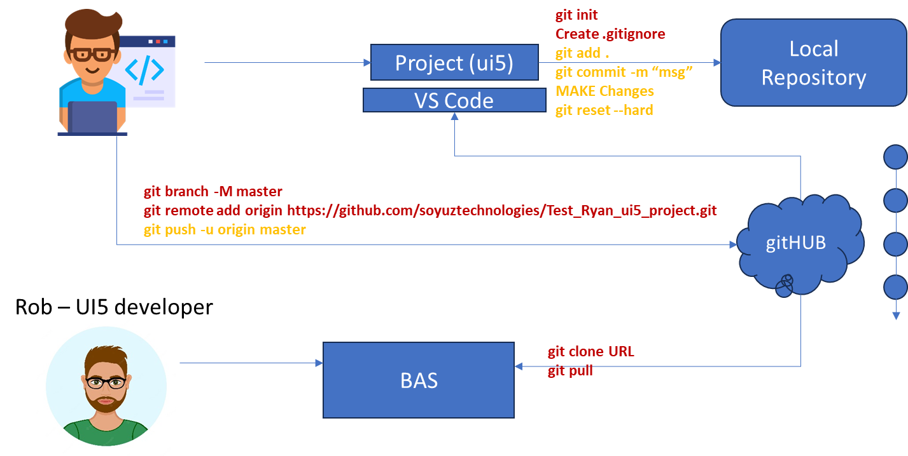
Git and Git HUB

Slide 15

Grant access of Build Workzone
register
BTP Admin
Anubhav
Developer
Raj Shetty
Security Admin
Subu Swamy
Developer
Uday Shetty
sasoy29360@creteanu.com
Create subscription
SAP Build Workzone
Create subscription
Register business user uday Shetty - sasoy29360@creteanu.com
Cloud Identity Service
IDP
Selects as Admin to manage users, roles, permissions
Establish trust
BTP

Slide 16
www.anubhavtrainings.com
Thank You
End of Day 15
www.anubhavtrainings.com

Slide 17


We’re committed to empower you to be
FutureReady
through powerful training solutions.
We build the workforce of the future.
250+
Corporate Clients
30,000+
Learners Trained
25000+
Learners Placed
FREE WEBINARS
Sign up for free webinars with industry experts every fortnight!
Enroll Now!
Contact us today!
https://anubhavtrainings.com

